Slide 1
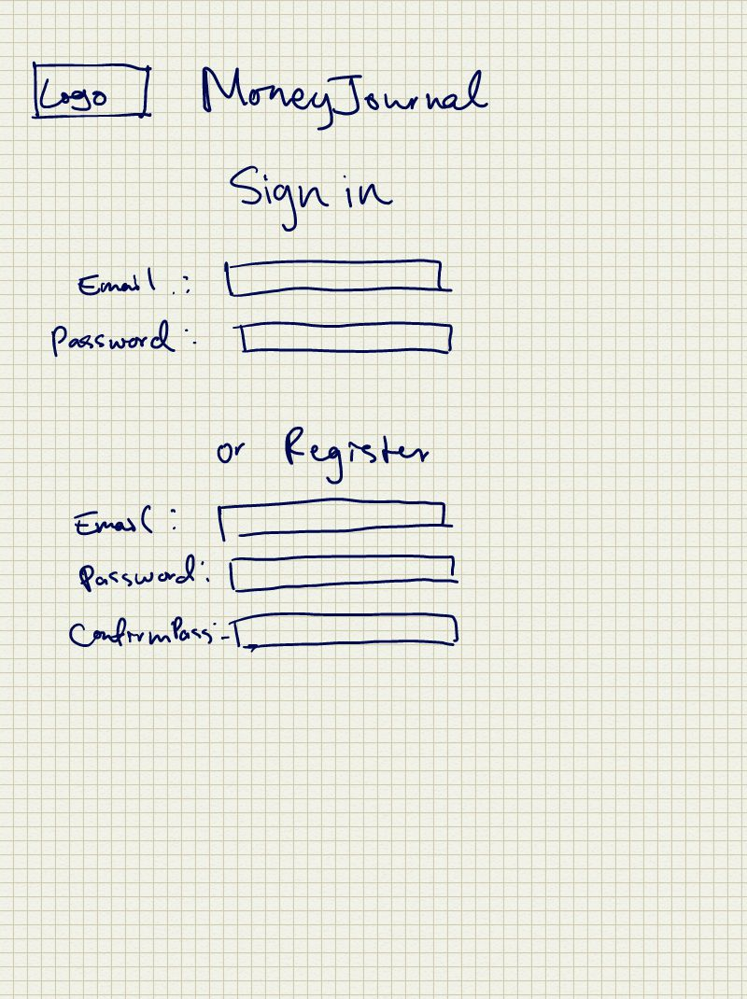
Storyboard
User will log in or register

Slide 2
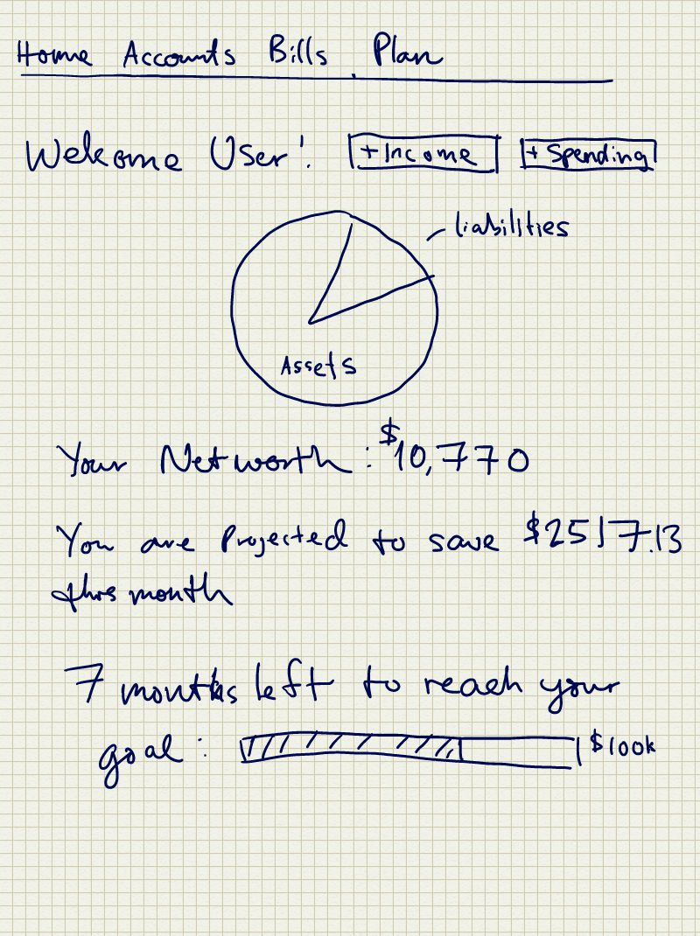
Landing page (Home)
Navigation bar:
Home
Accounts
Subscriptions
Bills
Plan
Add income
Add spending
Asset/liability chart
Net worth
Monthly projections
Goal progress

Slide 3
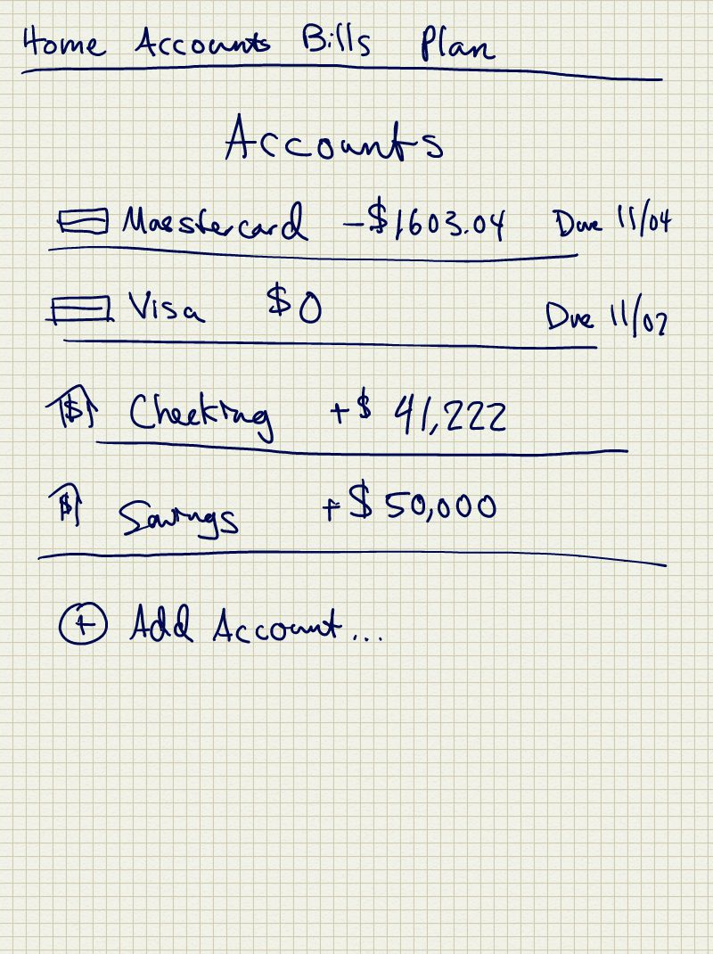
User can go to accounts
Can view account balances and payment due dates.
Can add an account
A form will appear
User will enter Nickname, Balance, and Monthly Due Date

Slide 4
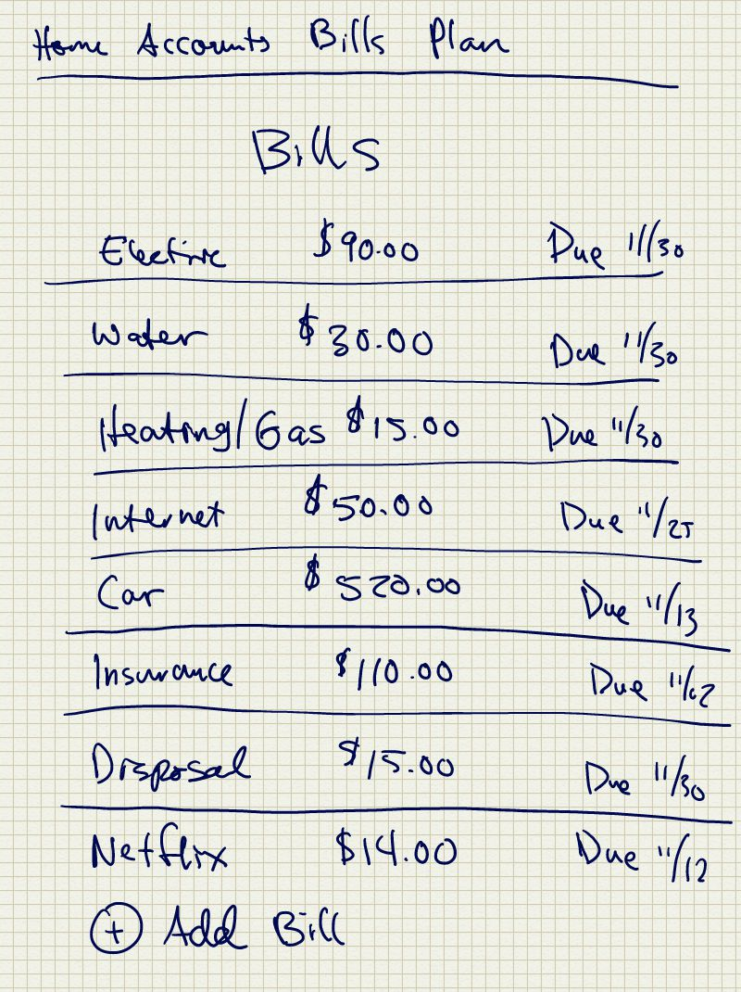
User can view bills or subscriptions
There are items that user has to pay no matter what and can vary based on usage
User can add bills and a form will appear
User will enter in Nickname, payment amount and payment due date.

Slide 5
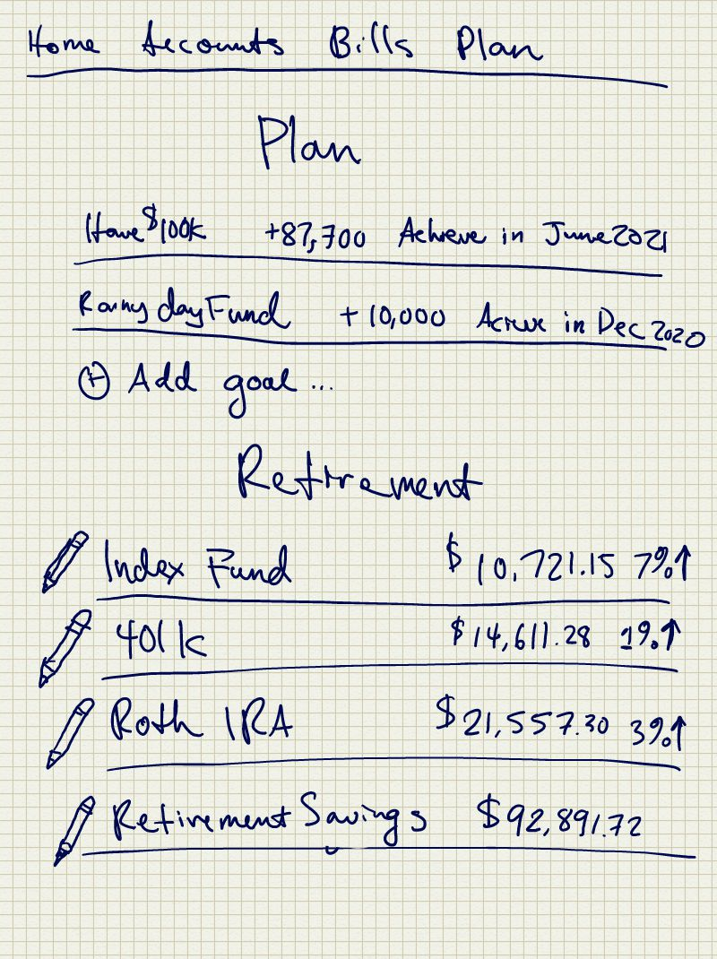
User can view plans and set goals
User can add goal and a form will appear
User can enter in Nickname for goal, set a goal amount and a goal date.
Stretch Feature:
User can also plan for retirement
Index Fund, 401k, Roth, Savings are preset columns that the user can take advantage of
User can click the pen icon to edit/update the column based on how much they have saved or invested.

